Slide 1
In Self-Defense: A Universal Innate Flu-Fighters from Human to Fish and Beyond
Shanzida Siddique
BFIX550
05/09/2018

Slide 2
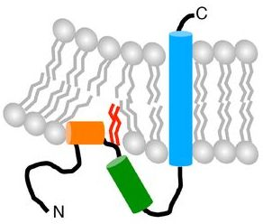
Interferon-inducible Transmembrane Proteins (IFITMs)
Interferon
inducible
IFITM5
IFITM2
IFITM1
IFITM3
IFITM10
Human Chr 11
26.5 Kb
1.4 Mb
Interferon-inducible Transmembrane Proteins (IFITMs)
- Five different types: IFITM1, 2, 3, 5 and 10
All are in Chromosome 11
IFITM1, 2, and 3 are interferon-inducible
Chesarino et al, EMBO Reports 2017

Slide 3
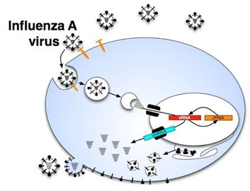
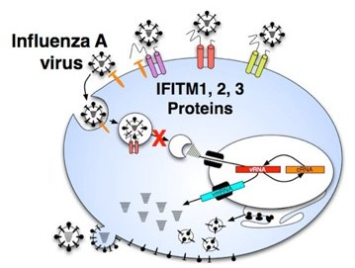
IFITMs : Mechanism of Anti-viral Defense
Restricts Influenza A, Dengue, West Nile, HIV-1 & many others.
IFITM3 shows highest anti-viral activity
(-)IFITMs
(+)IFITMs
Viruses
Notes:
Influenza A virus (top panel) infection begins with the virus binding to host cell receptors (orange). Following endocytosis, viruses undergo membrane fusion, permitting their genomes, called viral RNAs (vRNAs), to enter the host cell. The vRNAs are transported into the nucleus, where the influenza A polymerase makes viral mRNA (vmRNA), and a template (cRNA) for creating more vRNAs. The newly synthesized vRNAs and proteins are trafficked to the cell surface, where they are packaged into progeny virions. The anti-viral IFITM proteins, 1, 2 and 3 (bottom panel), block influenza A virus at entry using an unknown mechanism. IFITM proteins may block virus entry by sequestering the incoming viruses at the surface, by blocking viruses from binding to host receptors, by preventing endocytosis

Slide 4
IFITMs belongs to CD225/Dispanin Family Proteins
- IFITM1 has also recently been designated CD225 (cluster of differentiation 225)/Dispanin family
- There are 14 human members in this gene family
Dispanin family
IFITM3

Slide 5
Evolutionary and Functional Conservation of IFITM3
2009

Slide 6
Hunting for IFITM3-like Proteins/Novel genes in Fish

Slide 7

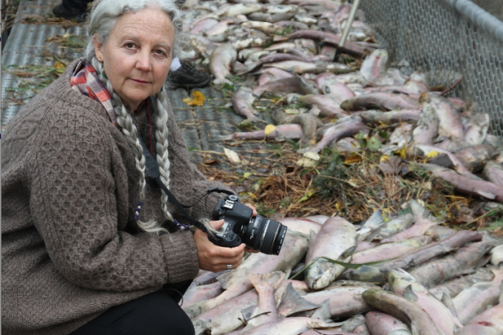
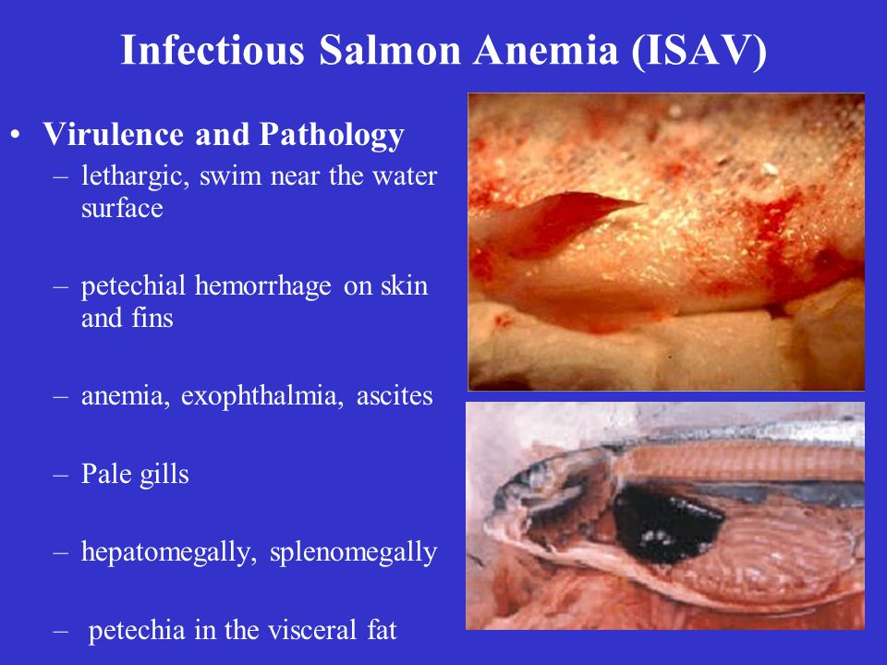
Why Fish?
http://slideplayer.com/slide/3796408/
https://www.vancouverobserver.com/blogs/earthmatters/racing-salmon-influenza-virus
The infectious salmon anemia virus, ISAV, is a branch of the influenza family that infects salmon. It is spreading wherever Atlantic salmon are held in feedlots. There is no cure
Do Fishes have any IFITM3-like gene(s)?

Slide 8
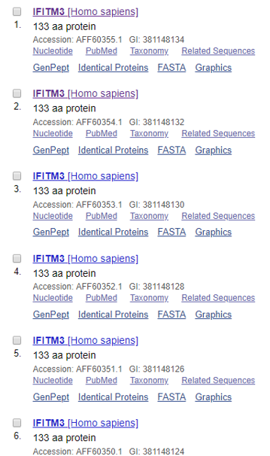
Step-1

Slide 9
Gene Info: Human
Official Symbol: IFITM3
Official Full Name: interferon induced transmembrane protein 3
RefSeq status: REVIEWED
Also known as: 1-8U; IP15; DSPA2b
Summary:
The protein encoded by this gene is an interferon-induced membrane protein that helps confer immunity
to influenza A H1N1 virus, West Nile virus, and dengue virus. Two transcript variants, only one of them
protein-coding, have been found for this gene. Another variant encoding an N-terminally truncated
isoform has been reported, but the full-length nature of this variant has not been determined.
Expression:
Ubiquitous expression in liver (RPKM 370.9), placenta (RPKM 358.2) and 25 other tissues

Slide 10
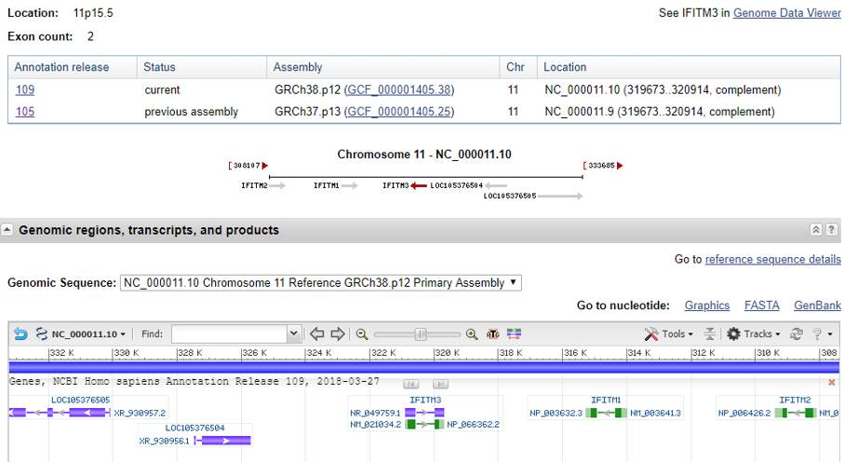
Genomic Context

Slide 11
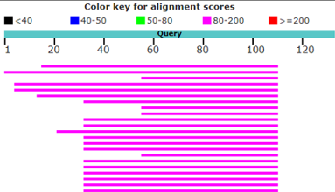
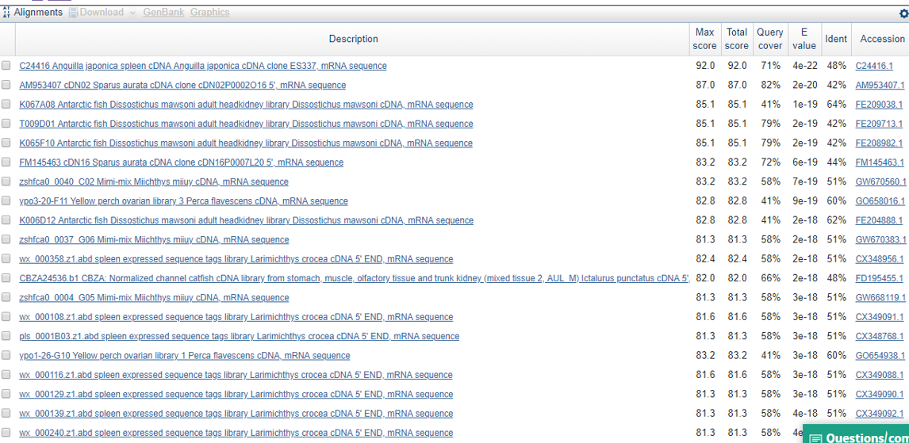
Searching for a Homologue in Fish: TBLASTN

Slide 12
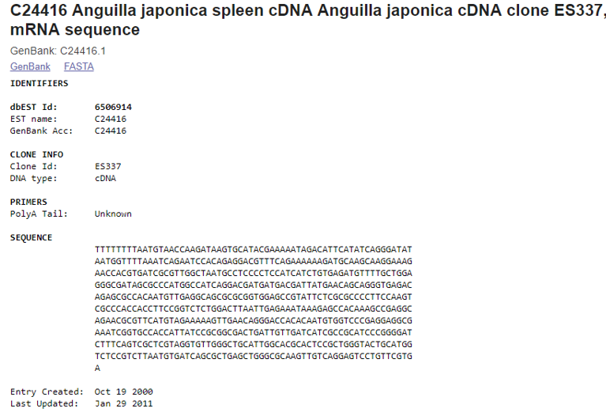
Full cDNA Sequence of A. japonica

Slide 13

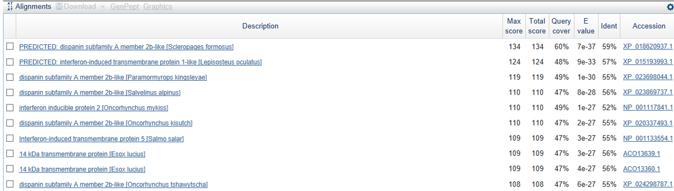
BlastX for Novelty Testing

Slide 14
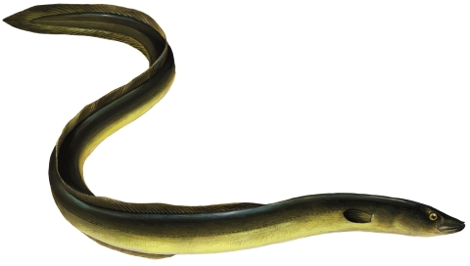
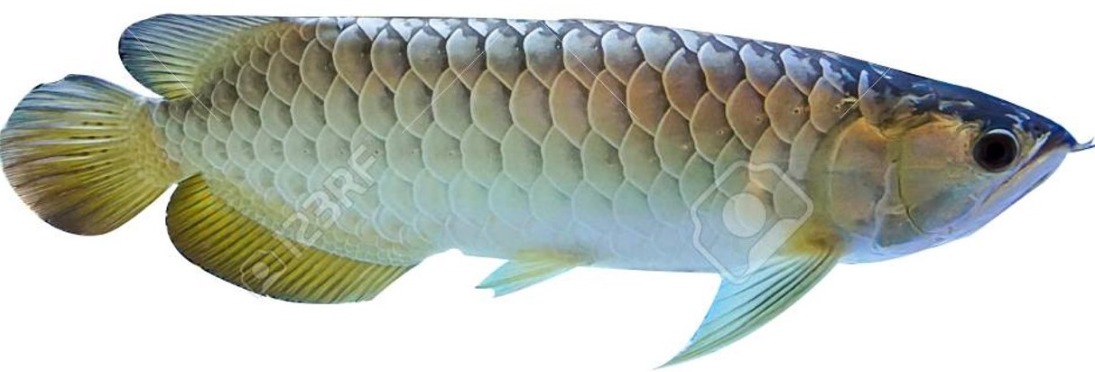
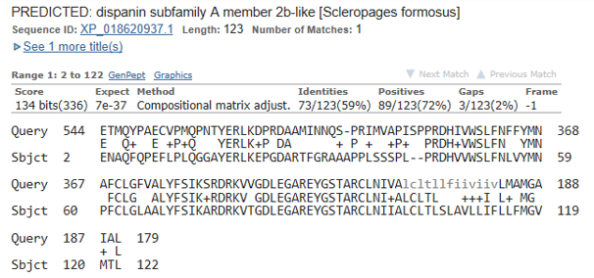
A Closer Look to Known Best Homologue of A. japonica C24416
Anguilla japonica
Scleropages formosus
>XP_018620937.1 PREDICTED: dispanin subfamily A member 2b-like [Scleropages formosus] MENAQFQPEFLPLQGGAYERLKEPGDARTFGRAAAPPLSSSPLPRDHVVWSLFNLVYMNPFCLGLAALYF SIKARDRKVTGDLEGAREYGSTARCLNIIALCLTLSLAVLLIFLLFMGVMTLY

Slide 15
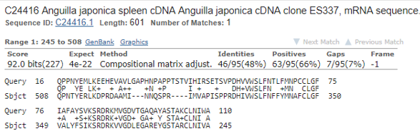
Comparison of Human IFITM3 to A. japonica C24416

Slide 16
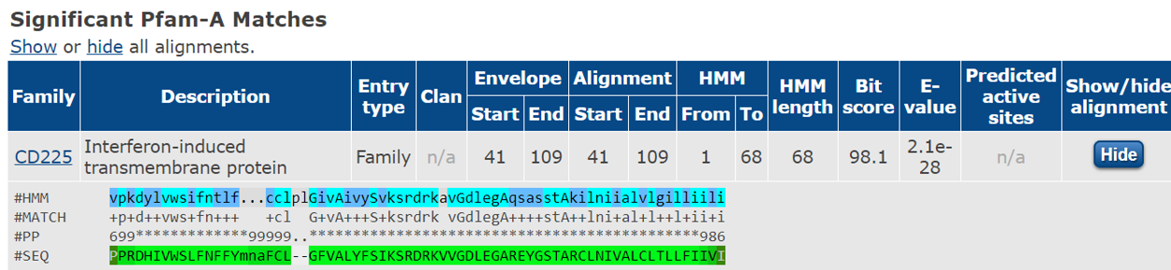
Pfam Domain Analysis
1 domain found: CD225

Slide 17
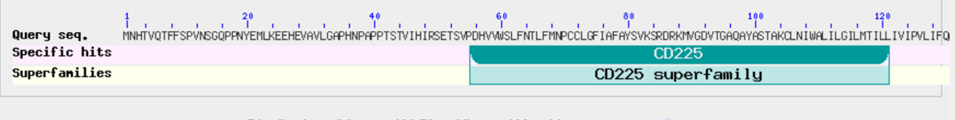
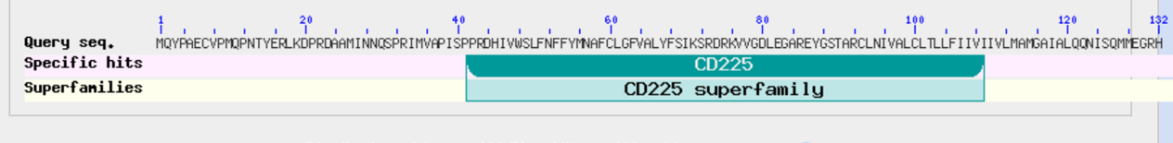
Protein Domain Conservation Between IFITM3 and C24416
IFITM3
C24416

Slide 18
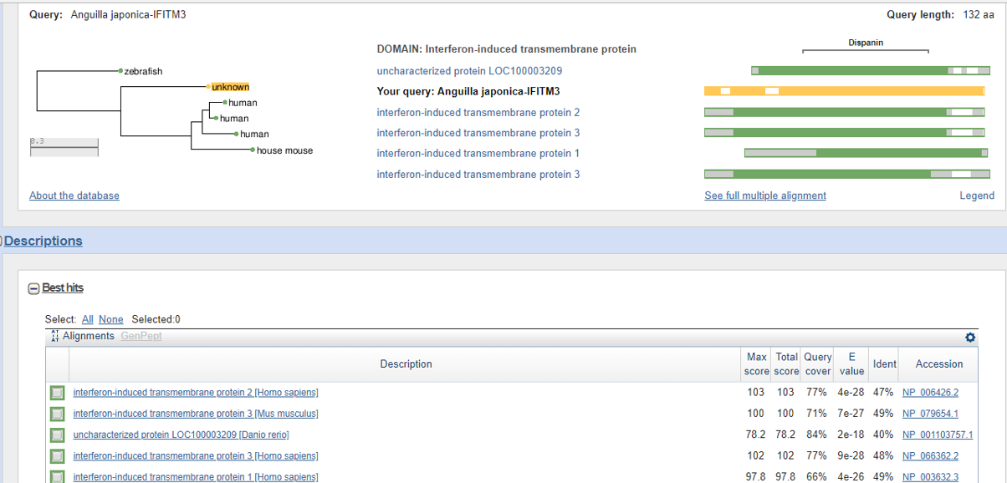
SMART-BLAST: Five Best Protein Matches from Well-Studied Reference Species
C24461

Slide 19
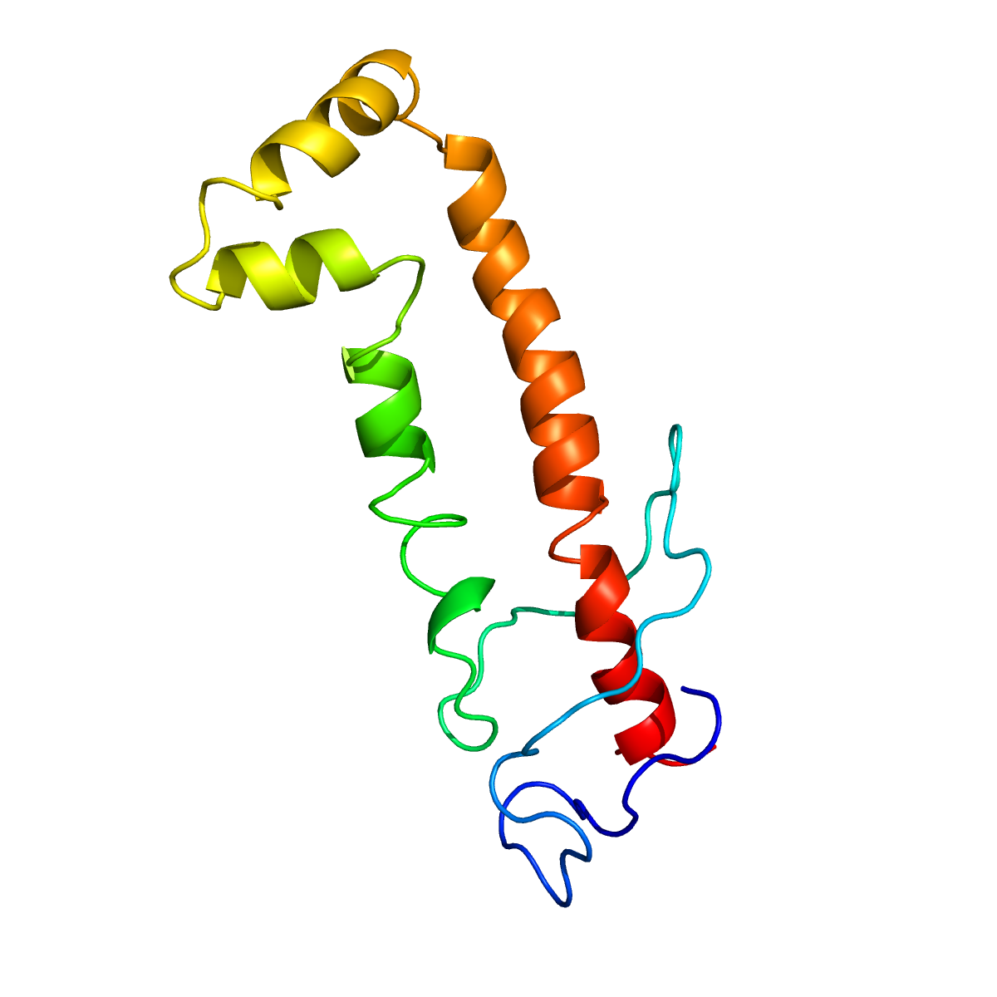
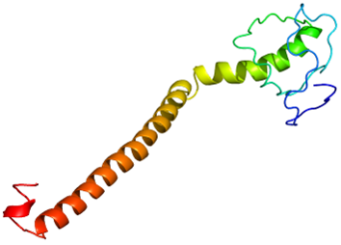
Predicted Structural Difference between IFITM3 and C24416
No structure has been solved for Human IFITM3 so far
Predicted both IFITM3 and C24416 structure by Phyre2
Human IFITM3
A. japonica C24416

Slide 20
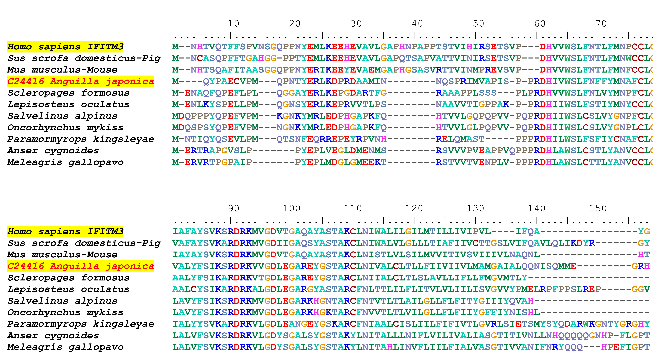
CD225
CD225

Slide 21
Phylogenetic Position of C24416
Fish
Birds
Mammals

Slide 22
Summary and Future Directions
C24416 from A. Japonicum is potentially a novel gene not described before
The protein potentially play IFITM3-like role such as anti-viral function due to presence of CD225 domain
Phylogenetic tree suggests that C24416 might be distantly related to IFITMs
Further studies are needed
A. to determine if the gene is induced by interferon
B. to test its role in anti-viral defense by in vitro expression

Slide 23
Thank You

